Slide 1
SOFTWARE PROJECT LAB-I
Team-15
Web Based Shooting Game

Slide 2

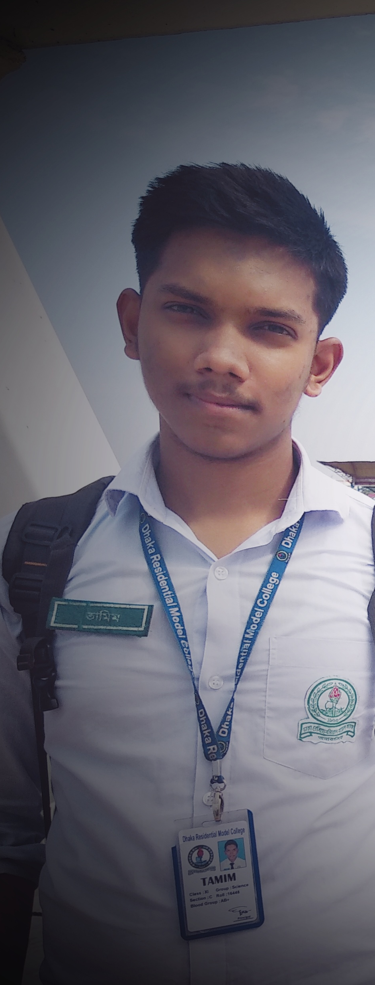

OUR TEAM
Md. Monowarul Amin
Md.Siamul Mubin Tamim
Sami-Ul Haque Showviq
ID: 200042112
ID: 200042130
ID: 200042156

Slide 3
TABLE OF CONTENTS
01
04
Team
Showing Games
02
05
About The Project
Requirments
03
06
Behind The Story
Timeline
3 members
Simple Presentation
Web Based Shooting Game
HTML,CSS,JS,MySQL
“WOW” word
Week 4 to Week 14

Slide 4

ABOUT THE PROJECT
Game

Slide 5
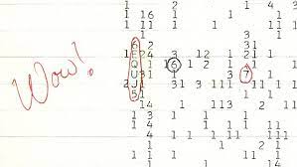

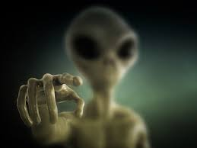


Story Behind The Game
On August 15,
1977
Radio Signal
WOW
Extraterrestrial Intelligence

Slide 6



With
Aliens
Interact
Sub Atomic Particles

Slide 7






Score:+100
Stars
Shooting Game
Particle

Slide 8


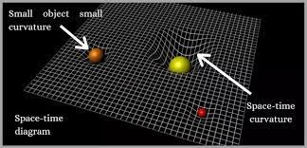
Solution
! Lower Lifetime
Of Sub-Atomic Particles
Special Theory of Relativity

Slide 9





MAJOR REQUIREMENTS
HTML
CSS
JS
MySQL

Slide 10
OUR TIMELINE
WEEK 4 -5
WEEK 9-11
FINAL
VERSION
WEEK 6-8
WEEK 12-14
Finalizing The Proposal
Develpoing the fundamental coding
Planning
Proposal
Developing the base template
Working with database and front-end

Slide 11
THANKS!

